Slide 1
Federated FREEBUSY Challenge Demo
The Open Group Quarterly Meeting
17th-20th July 2006
Coral Gables, Florida
Wen Fang (Boeing)
Mike Douglass (RPI)
Gary Schwartz (RPI)

Slide 2
Why We are here
"Increasingly in business, there is a need to schedule meetings with people (within or outside of the company) using different calendaring systems without multiple interactions and iterations, which prove to be time consuming and inefficient. What is needed is a simple mechanism to see when a group of people would be available for a meeting."

Slide 3
Open Group Vendor Challenges
A vendor challenge is a very practical way to address the blockages that prevent deployment of a new technology, and in the context of work within The Open Group, this means the deployment of a new standards-based technology.
The whole project is completed within the context of a very specific problem reported by one or more IT user organizations. This is important because it demonstrates to product vendors that there is a ready market for a solution to the problem, and encourages their active participation.

Slide 4
Who We Are
The Open Group
The Open Group is a vendor- and technology-neutral consortium, whose vision of Boundaryless Information Flow™ will enable access to integrated information within and between enterprises based on open standards and global interoperability.
In accordance with its vision and mission, The Open Group works towards enabling access to integrated information within and between enterprises based on open standards and global interoperability.

Slide 5
Who We Are
CalConnect - The Calendaring and Scheduling Consortium
The Consortium is focused on the interoperable exchange of calendaring and scheduling information between dissimilar programs, platforms, and technologies.
The Consortium's mission is to promote general understanding of and provide mechanisms to allow interoperable calendaring and scheduling methodologies, tools and applications to enter the mainstream of computing.

Slide 6
Who We Are – the Presenters
Wen Fang
Sr. System Analyst
The Boeing Company
Mike Douglass
Sr. Systems Programmer
Lead architect of Bedework
RPI
Gary Schwartz
Director, Communications & Middleware Technologies
RPI
Drew Garcia
Director, Product Management
Timebridge

Slide 7
Chronology
2005/Q1 Brought to the Messaging Forum by The Boeing Company and Noventum Consulting
2006/Q1 Messaging Forum issued Federated Free/Busy Challenge
2006/Q1 Representatives of Open Group brought FREEBUSY Challenge to CalConnect
2006/Q2 proof of concept solution sketched out at Quarterly Meeting in Washington, D.C. to be promoted as a joint project between The Open Group and the Calendaring & Scheduling Consortium
2006/Q3 Demo of Proof of Concept Solution at Quarterly Meeting in Miami
2006/Q4 The Challenge final report to be published

Slide 8
What We Will be Showing You
Requests to multiple calendar servers in multiple locations from multiple vendors for FREEBUSY information for multiple users
Management of these requests and aggregation of requested information from web-based applications
An interim solution which (adroitly) sidesteps some issues that will be need to addressed at some point.

Slide 9
Why this is Significant
Major groupware applications already do this, but not in a heterogeneous calendaring environment which spans administrative and geographical domains.
It is the first step towards solving a problem which needs to be solved.

Slide 10
The Requirements
Uses open standard protocols
Can be implemented today
Crosses timezones, cultures, calendaring systems, corporate and network boundaries

Slide 11
Relaxed Constraints
For a constrained list of named attendees
For a constrained list of times.
Restricted to organizations that have server based calendaring systems
No provision for confirmation that times are acceptable or for updating calendars
Can initially exclude provision for recurring meetings

Slide 12
Architectural overview
An organizer, aggregator, "avatar" program (or controller) providing the user interface, having knowledge of attendee lists and groups, perhaps embed local business logic, and some useful level of functionality aggregating and displaying results from the FREEBUSY queries.
A CalDAV-compliant free/busy interface (CC-FBI) layer (or "proxy" which would field CalDAV free/busy queries from, and return results to, the organizer program. This interface would only have to support enough CalDAV to support free/busy queries.
A number of "connector" servers or services, at the edge of the network, to interface to systems which do not support CalDAV.

Slide 13
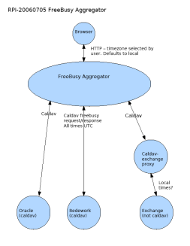
Architectural Overview – from the clouds

Slide 14
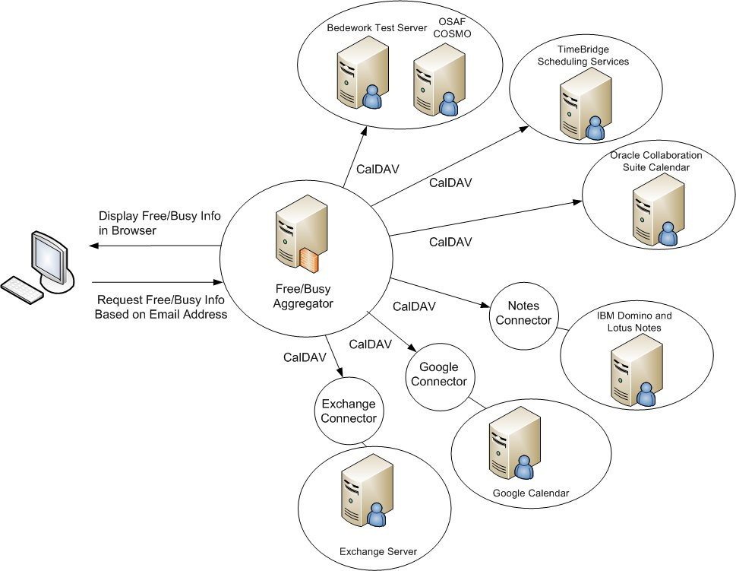
Architectural View – “From the Clouds”

Slide 15
How we did it
Coordinated in the CalConnect FREEBUSY technical committee
Modified code from the open source Bedework calendar
“Connector” code contributed by IBM, Boeing, and TimeBridge
Cooperative and collegial development and testing among calendar developers

Slide 16
The Secret of Our Success - CalDAV
CalDAV is designed for implementation by any collaborative software, client or server that needs to maintain, access, or share collections of events. It is being developed as an open standard to foster interoperability.
CalDAV builds upon extant standards (RFC 2445, WebDAV) while anticipating and allowing changes in the future such as XML representations of calendaring formats
Mozilla, Oracle, Open Software Applications Foundation, Novell, Bedework have publicly announced plans to support CalDAV
CalDAV provides enterprises the promise of comprehensive, interoperable, global calendaring solution

Slide 17
What We Learned
Enlightened self interest and open standards are a powerful combination
Even calendar developers who claim they use “open calendar standards” may have non-conforming implementations.
Open APIs are good. Widely adopted open standards are better.
Open standards need to be unambiguous ensure implementations will interpret those standards in interoperable way.

Slide 18
What remains to be done?
Adroitly solve the problems we are presently adroitly sidestepping:
  Discovery
  Authentication and access control
  Enfranchising additional calendaring systems
Migrate this solution to use the richer functionality of the still developing "Scheduling Extensions to CalDAV“ specifications.
Encourage wider participation among calendar developers and calendar users

Slide 19
Resources & References
http://www.opengroup.org/
http://www.calconnect.org/
http://www.bedework.org/
http://www.timebridge.org/
http://www.opengroup.org/messaging/challenges/fb-challenge.htm
http://ietf.osafoundation.org/caldav/index.html

Slide 20
Open Group Demo – July 18, 2006
Accessed FREEBUSY information from
  Bedework Calendar (native CalDAV)
  Oracle Collaboration Suite Calendar (native CalDAV)
  OSAF Cosmo (native CalDAV)
  Google Calendar (RPI-supplied connector)
  IBM Lotus Domino/Notes (IBM-supplied connector)
  Microsoft Outlook (TimeBridge-supplied connector)
  Microsoft Exchange (Boeing-supplied connector)

Slide 21
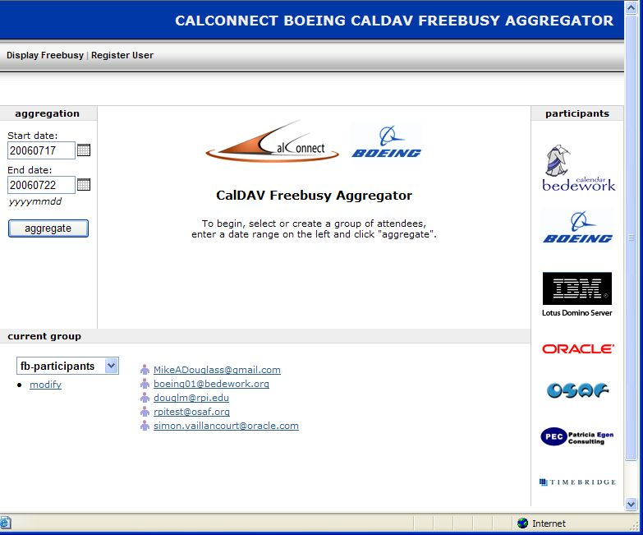
Aggregator Main Screen

Slide 22
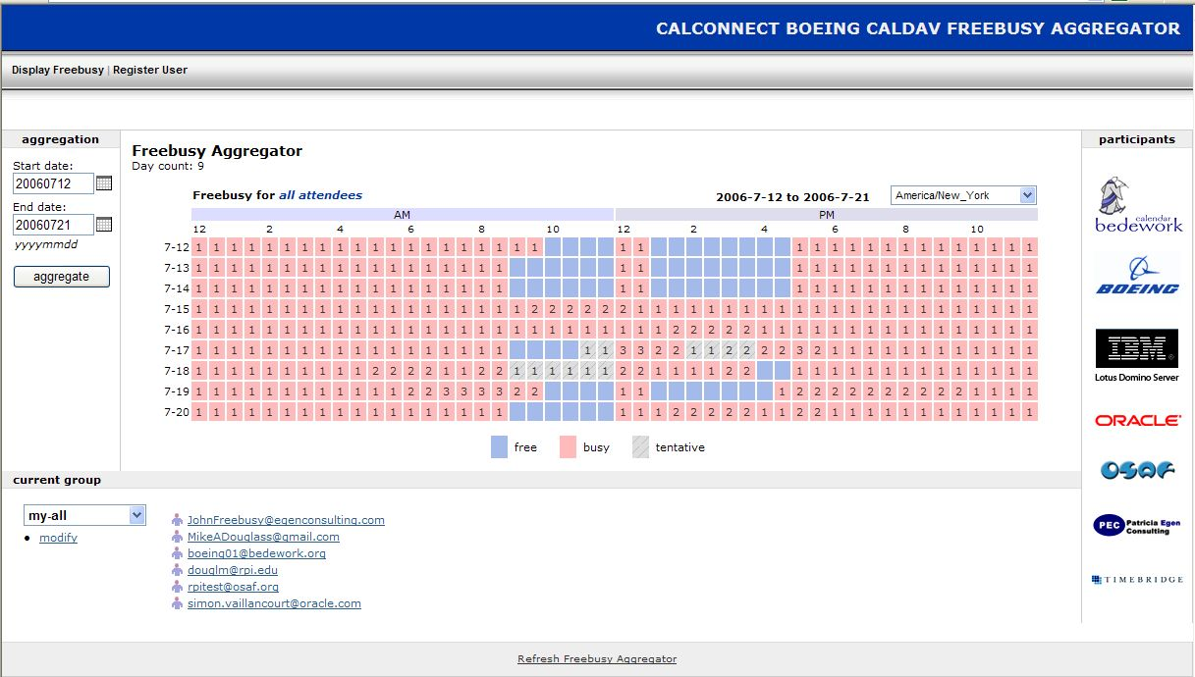
Aggregator FREEBUSY Display

Slide 23
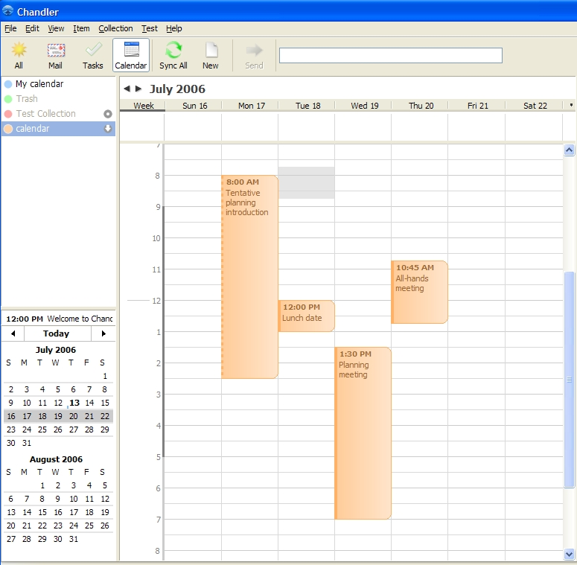
Chandler Calendar Screen Shot

Slide 24
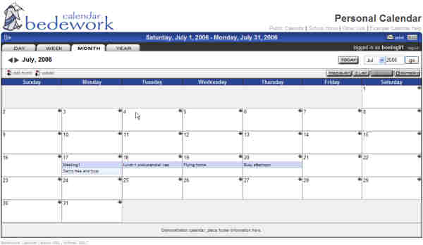
Bedework Calendar Screen Shot

Slide 25
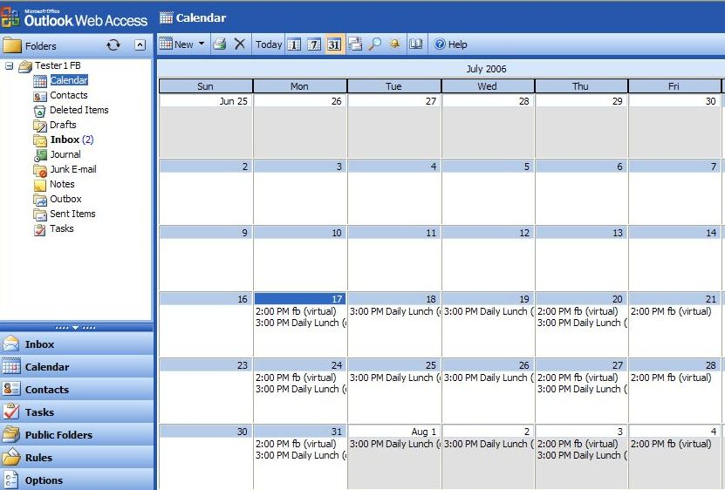
Boeing Exchange Calendar Screen Shot

